Slide 1

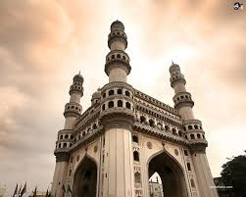



TELANGANA
GROWTH ANALYSE

Slide 2
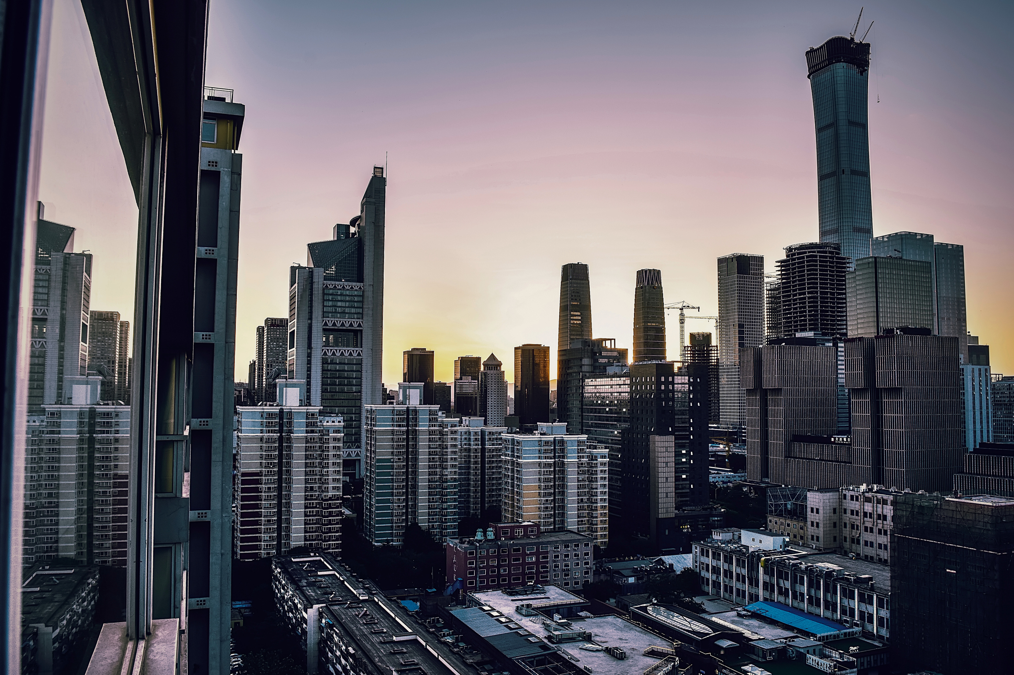
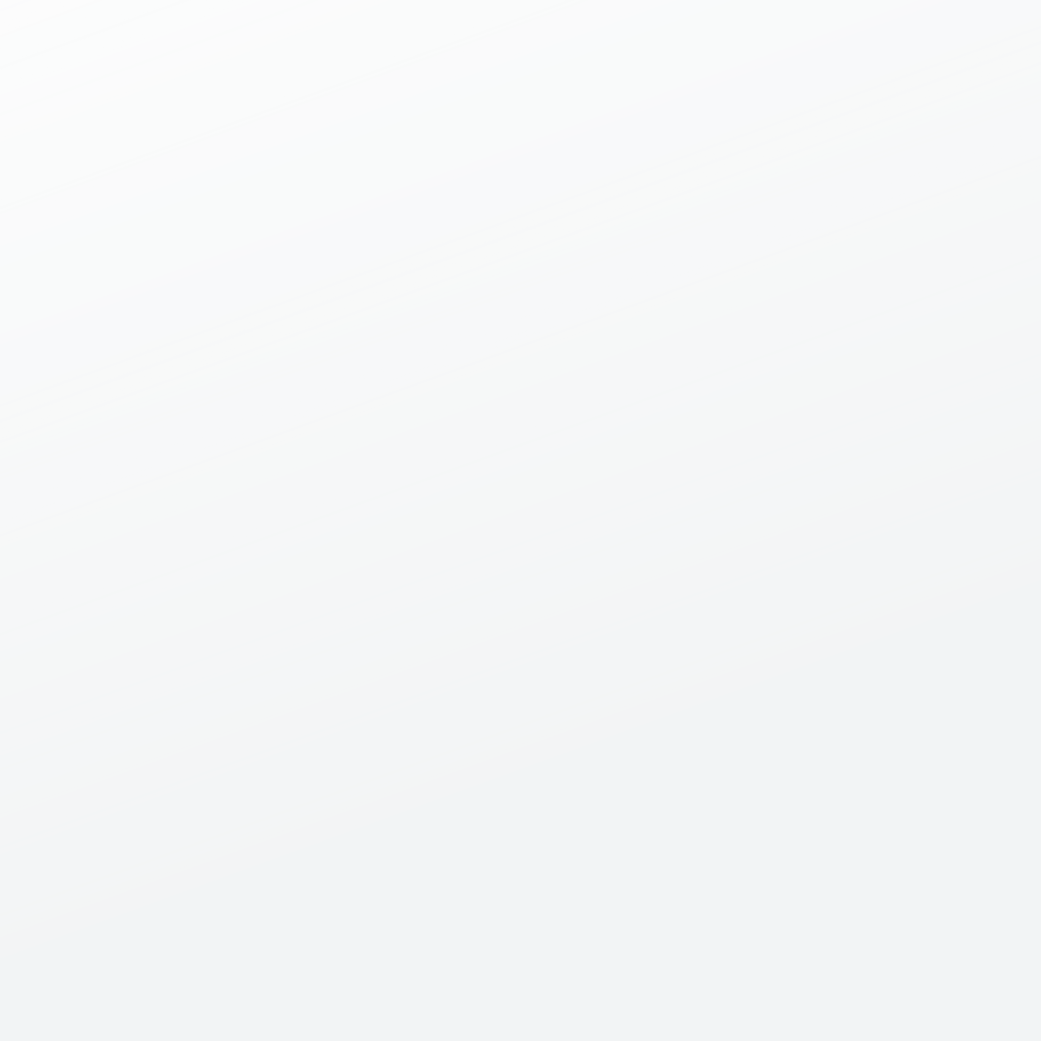
CONTENT
01
02
03
04
05
introduction
objective
about the
data
Primary
insights
secondary
insights

Slide 3
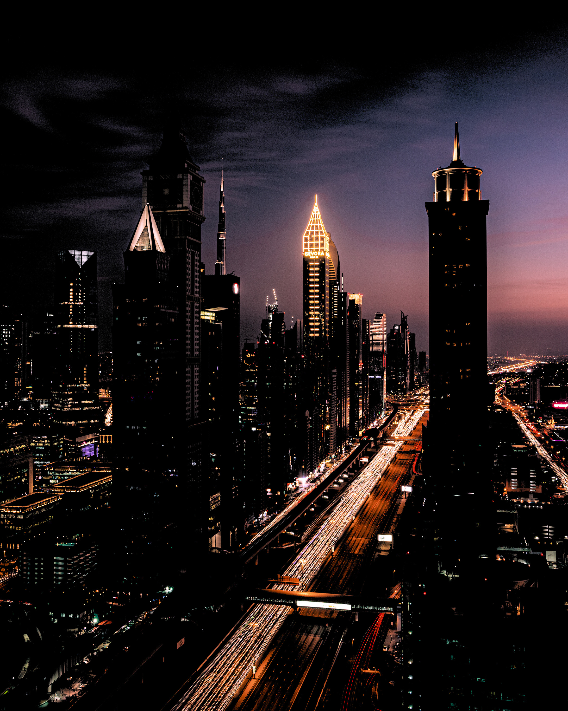
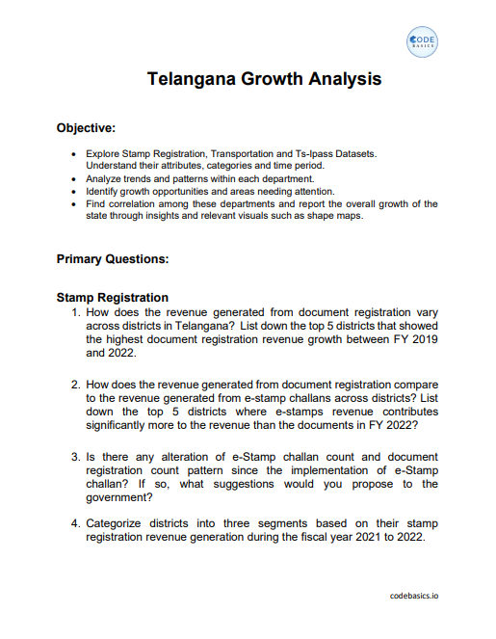

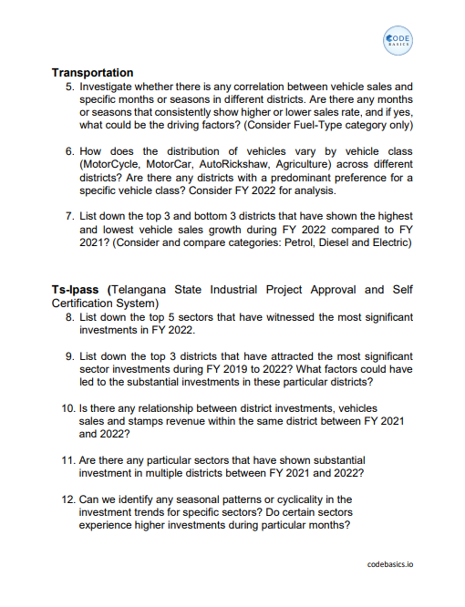
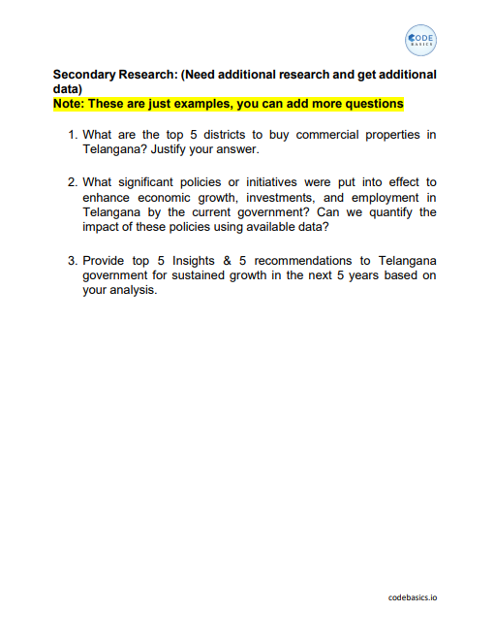

q
Tools and Questions

Slide 4
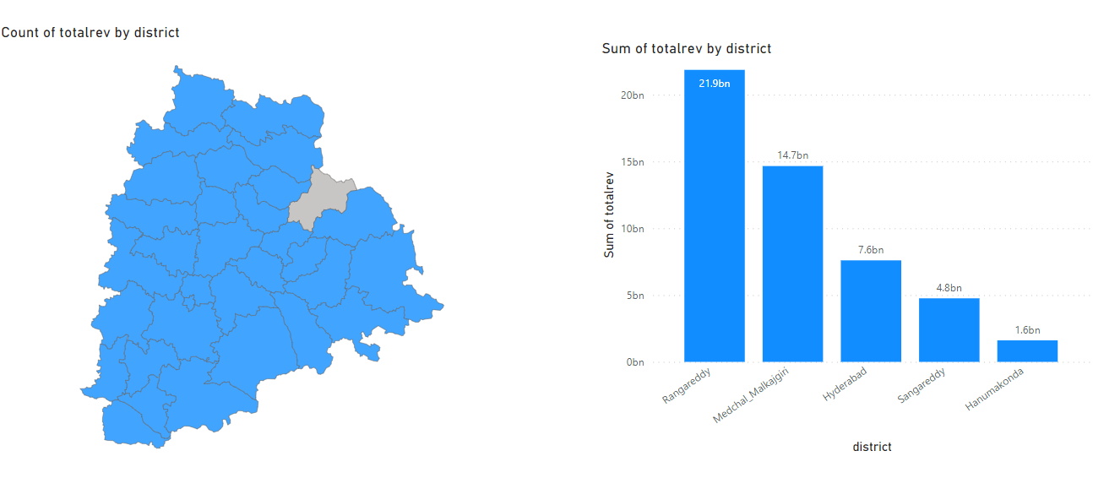
INTRODUCTION
01
Telangana is one of the 28 states of India, located in the southern part of the country. It was officially formed as a separate state on June 2, 2014, following a long-standing demand for statehood.
02
In 2022, GDP for Telangana was 129 million INR, lakhs. GDP of Telangana increased from 45.2 million INR, lakhs in 2013 to 129 million INR, lakhs in 2022 growing at an average annual rate of 12.53%.

Slide 5
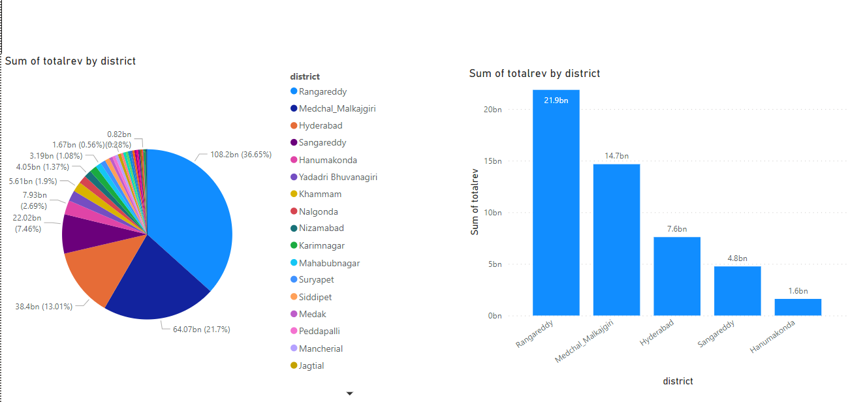
How does the revenue generated from document registration vary across districts in Telangana?
List down the top 5 districts that showed the highest document registration revenue growth between FY 2019 and 2022.

Slide 6
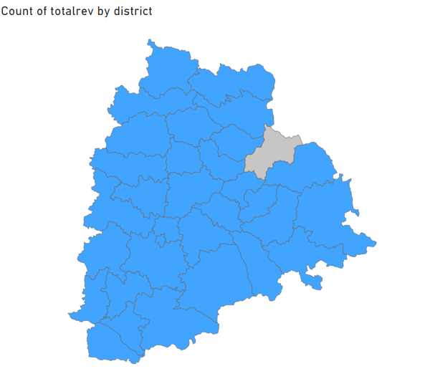

Slide 7
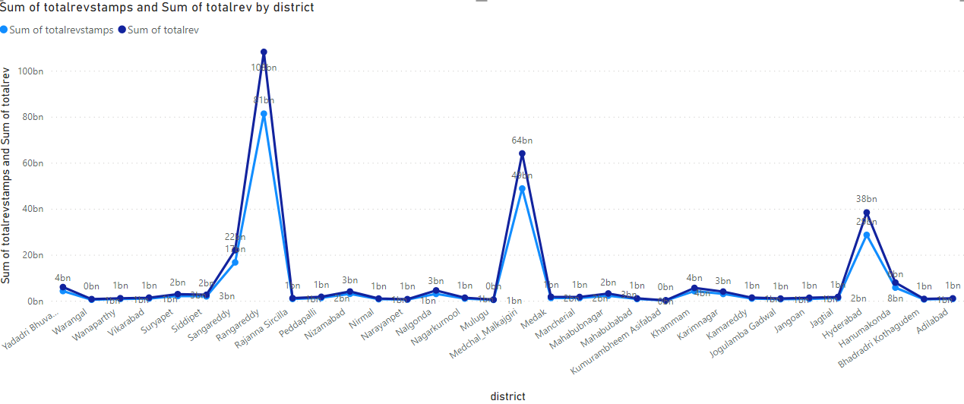
How does the revenue generated from document registration compare
to the revenue generated from e-stamp challans across districts?

Slide 8
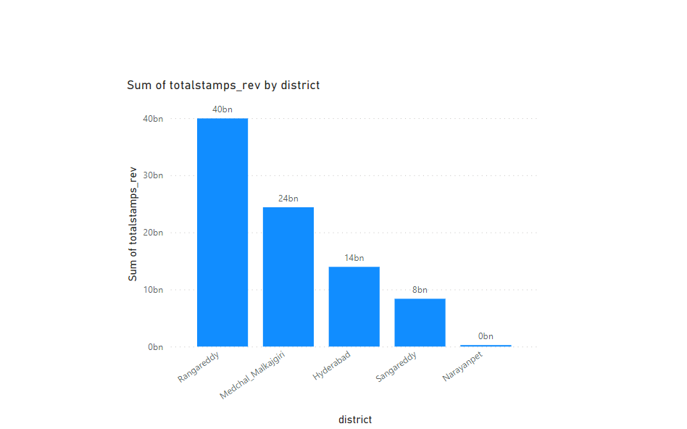
List down the top 5 districts where e-stamps revenue contributes significantly more to the revenue than the
documents in FY 2022?

Slide 9
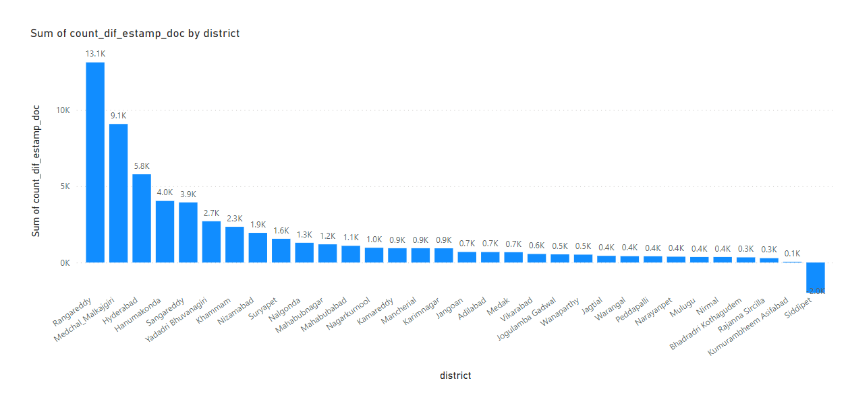
Is there any alteration of e-Stamp challan count and document registration count pattern since the implementation of e-Stamp challan ? If so, what suggestions would you propose to the government?
there is a increase in the count of e-stamp when compare to the document registration in all the districts except
for siddipet

Slide 10
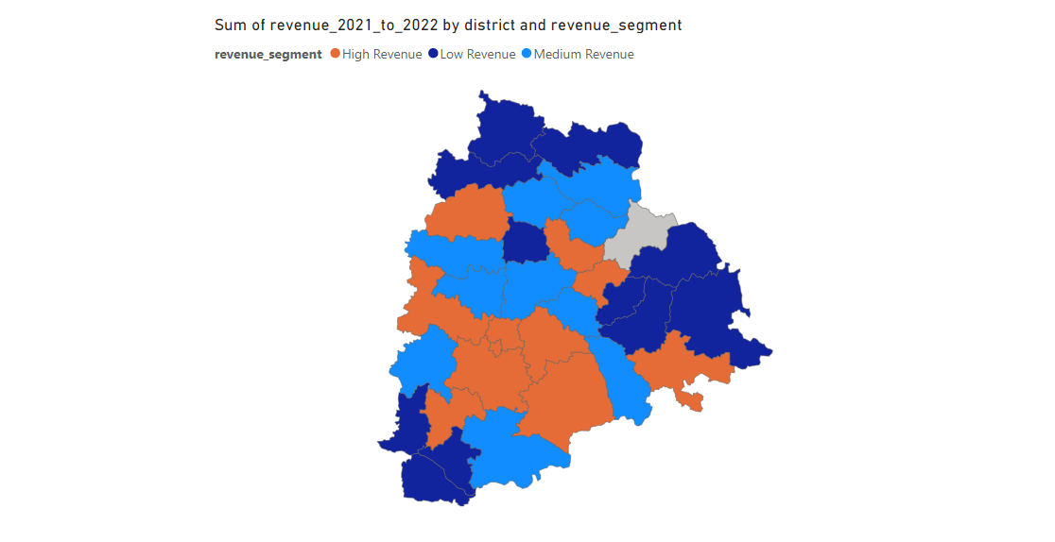
Categorize districts into three segments based on their stamp registration revenue generation during the
fiscal year 2021 to 2022

Slide 11
High Revenue
Rangareddy
Medchal_Malkajgiri
Hyderabad
Sangareddy
Hanumakonda
Khammam
Yadadri Bhuvanagiri
Nalgonda
Nizamabad
Karimnagar
Mahabubnagar
Medium Revenue
Suryapet
Siddipet
Peddapalli
Medak
Mancherial
Jagtial
Nagarkurnool
Vikarabad
Kamareddy
Jangoan
Low Revenue
Rajanna Sircilla
Adilabad
Mahabubabad
Jogulamba Gadwal
Nirmal
Bhadradri Kothagudem
Warangal
Narayanpet
Mulugu
Kumurambheem Asifabad
Wanaparthy

Slide 12
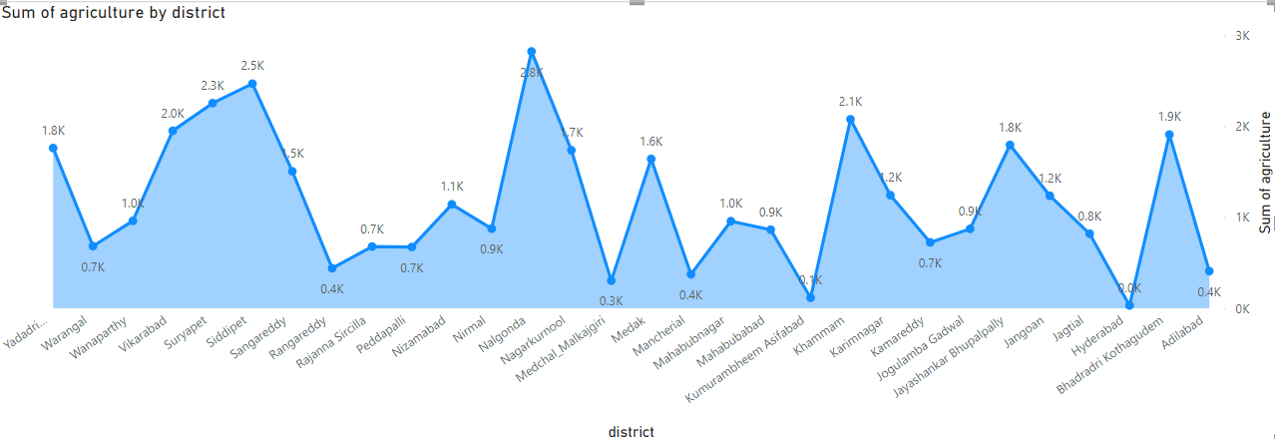
How does the distribution of vehicles vary by vehicle class (MotorCycle, MotorCar, AutoRickshaw, Agriculture) across different districts? Are there any districts with a predominant preference for a specific vehicle class?
Consider FY 2022 for analysis.

Slide 13
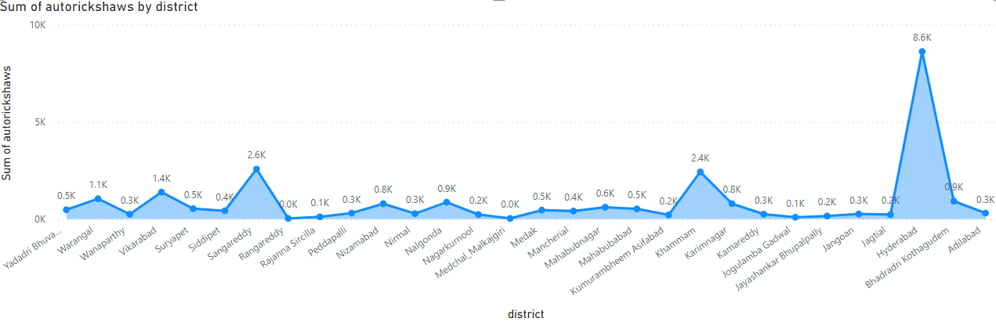
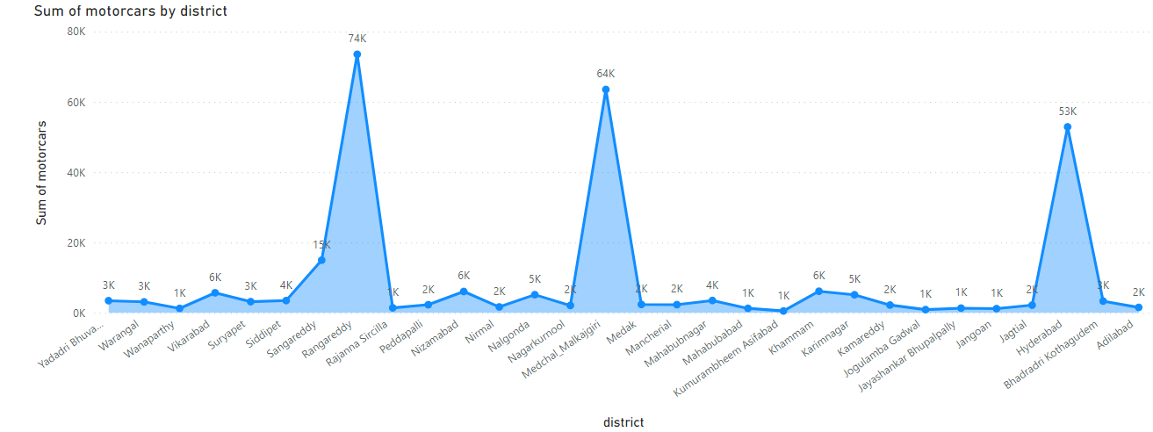

Slide 14
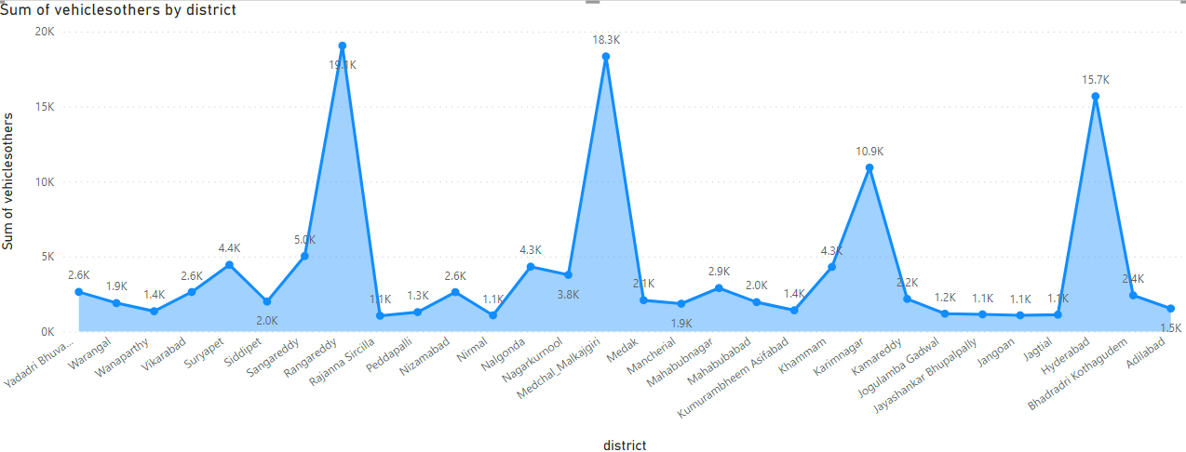
Districts with highest no of sales in different categories
Motorcycle - Rangareddy
Motorcar - Rangareddy
Auto Rickshaw - Hyderabad
Agriculture - Nalgonda

Slide 15
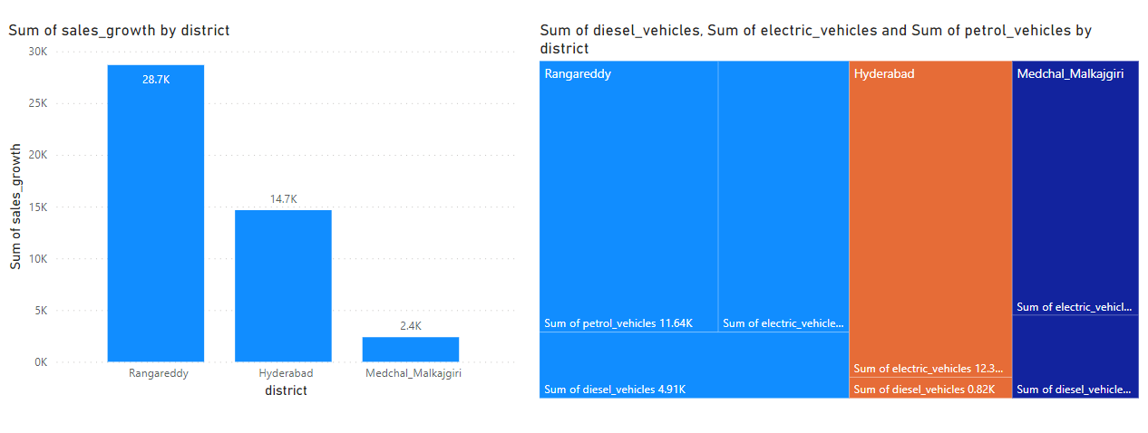
List down the top 3 districts that have shown the highest and lowest vehicle sales growth
during FY 2022 compared to FY 2021?

Slide 16
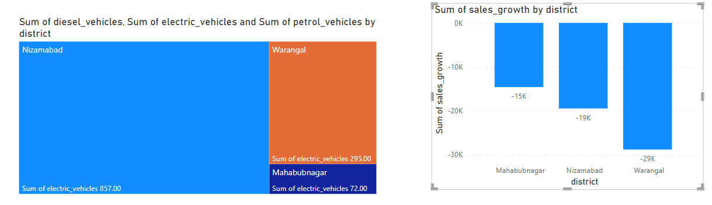
List down the bottom 3 districts that have shown the highest and lowest vehicle sales growth during FY 2022 compared to FY 2021?

Slide 17
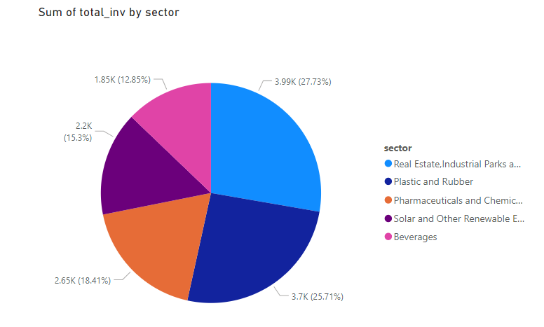
List down the top 5 sectors that have witnessed the most significant investments in FY 2022.

Slide 18
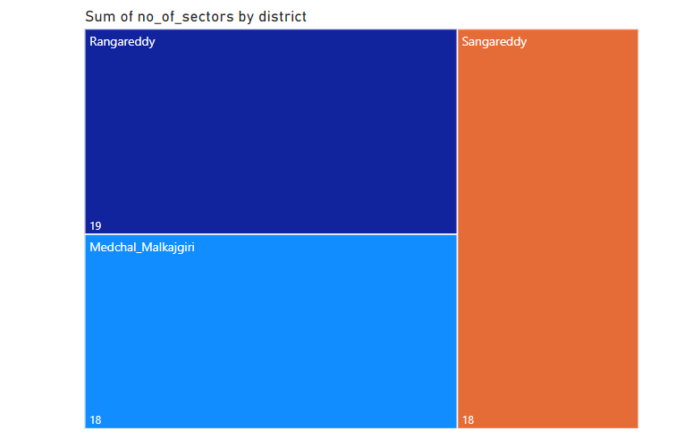
List down the top 3 districts that have attracted the most significant sector investments during FY 2019 to 2022? What factors could have led to the substantial investments in these particular districts?

Slide 19
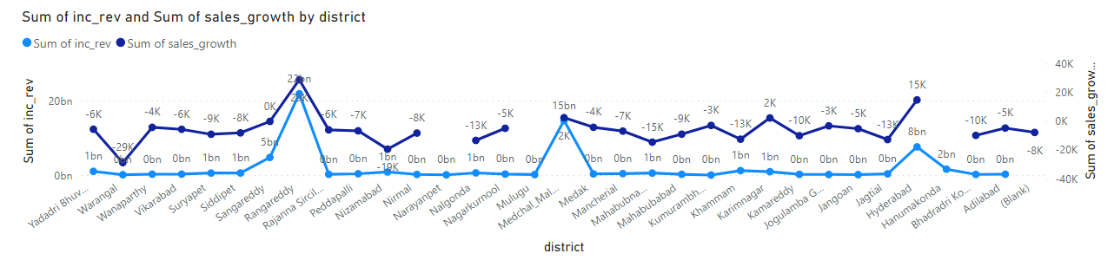
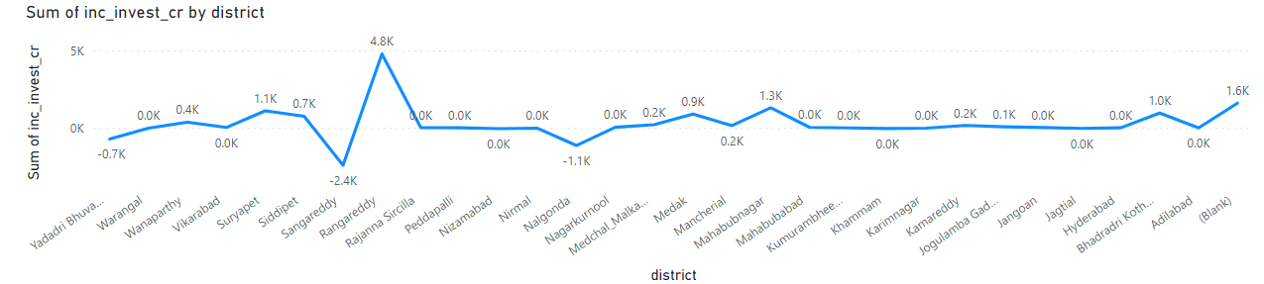
Is there any relationship between district investments, vehicles sales and stamps revenue within the same district between FY 2021 and 2022?

Slide 20
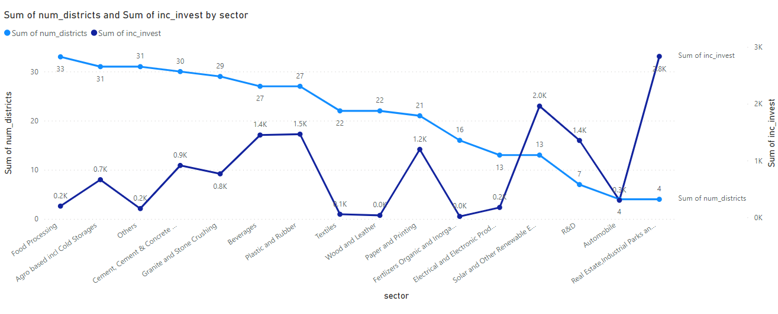
Are there any particular sectors that have shown substantial investment in multiple districts between FY 2021 and 2022?

Slide 21
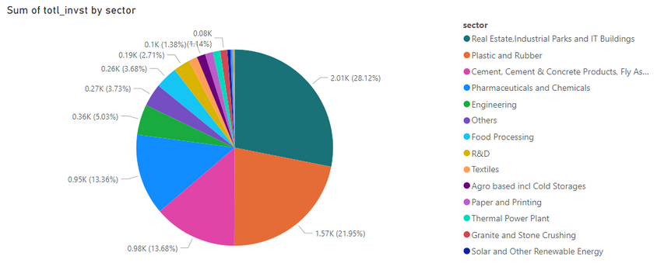
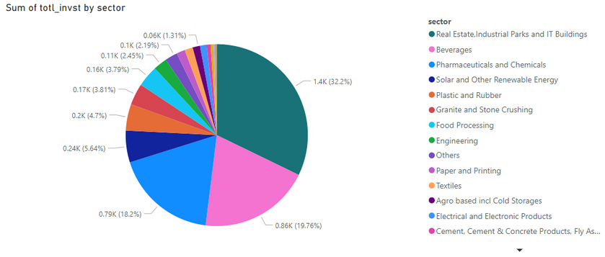
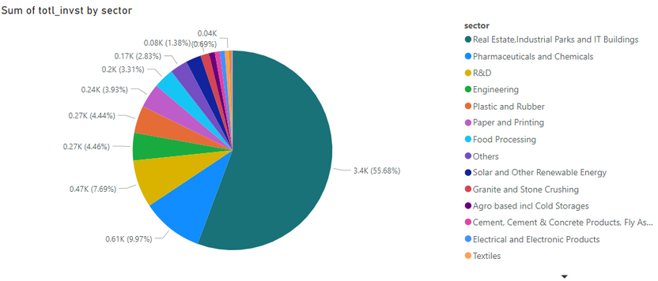
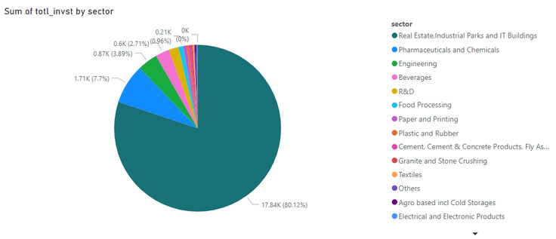
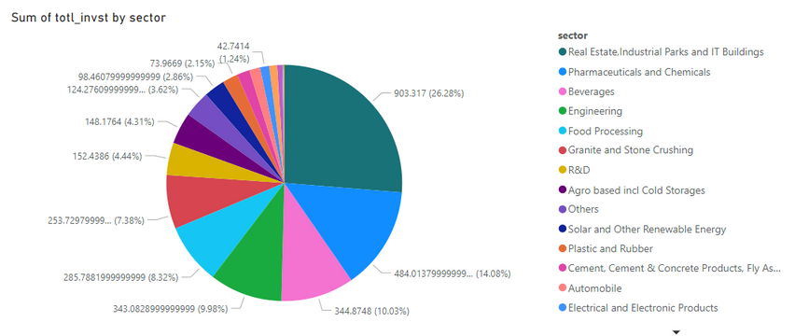
Can we identify any seasonal patterns or cyclicality in the investment trends for specific sectors? Do certain sectors experience higher investments during particular months?
Real Estate, Industrial Parks and IT Buildings
January - 1397.17 cr
February - 17843.3508 cr
March - 3398.9959 cr
May - 903.317 cr
August - 2007.67 cr

Slide 22
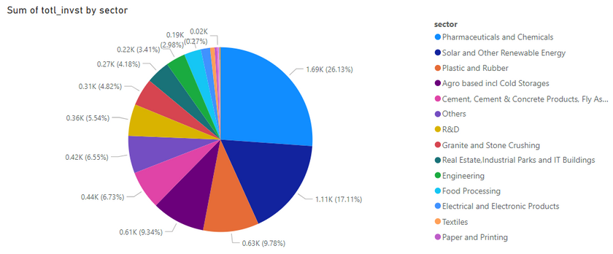
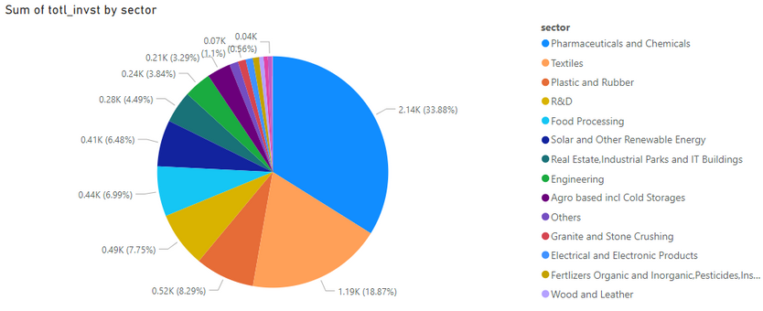
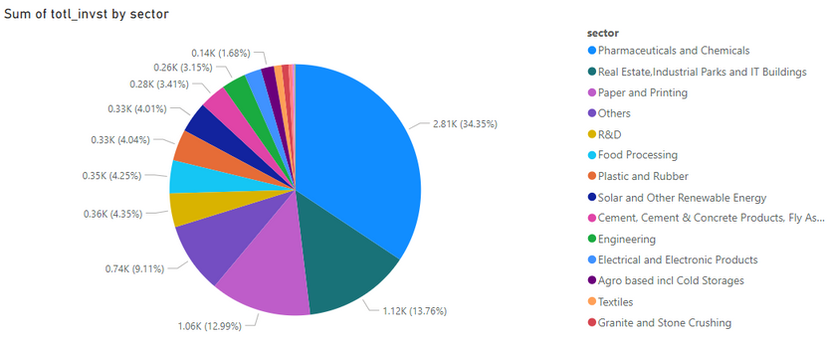
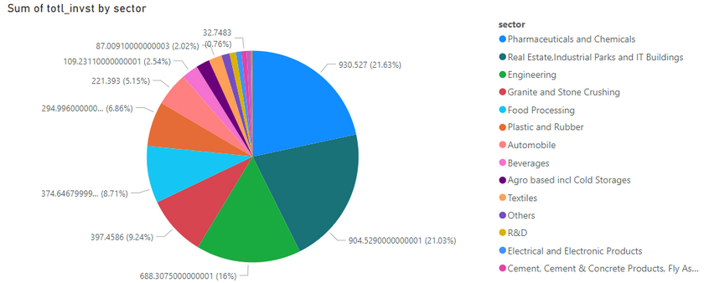
Pharmaceuticals and Chemicals
June
July
September
October

Slide 23
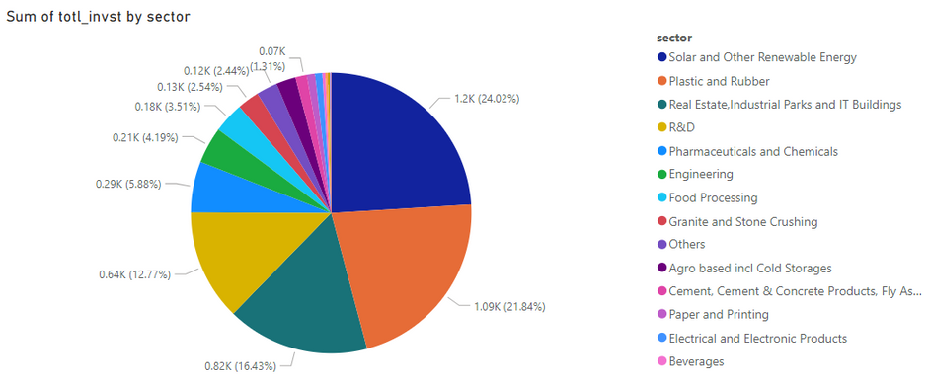
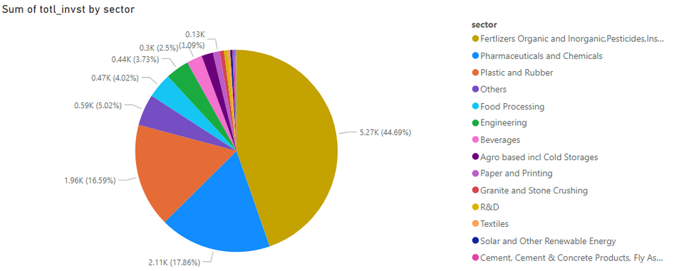
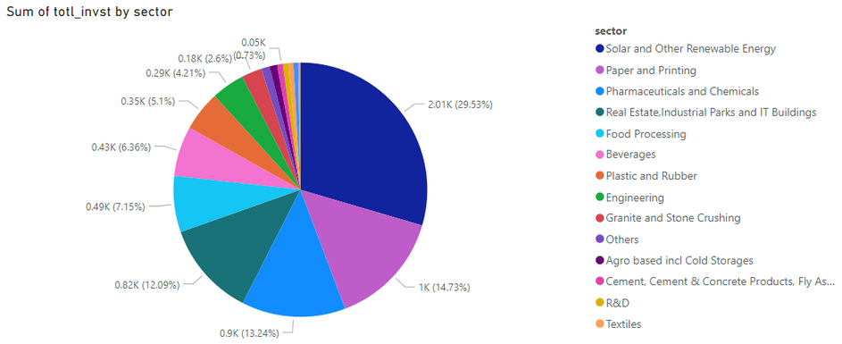
Fertilizers Organic and Inorganic,Pesticides,Insecticides, and Other Related
December
Solar and Other Renewable Energy
April
November

Slide 24
Thank you
Codebasics Team
1.Dhaval Patel
Founder, Codebasics
2.Hemanand Vadivel
Co-Founder, Codebasics
From Telangana Government
1. Kalvakuntla Taraka Rama Rao / KTR
Minister for IT, Industries and Municipal Administration:
2. Jayesh Ranjan
Secretary, Information Technology (IT); Government of Telangana:
3. Dileep Konatham
Director at Government of Telangana
4. Venu Panjarla
Open Data Telangana

